Slide 1
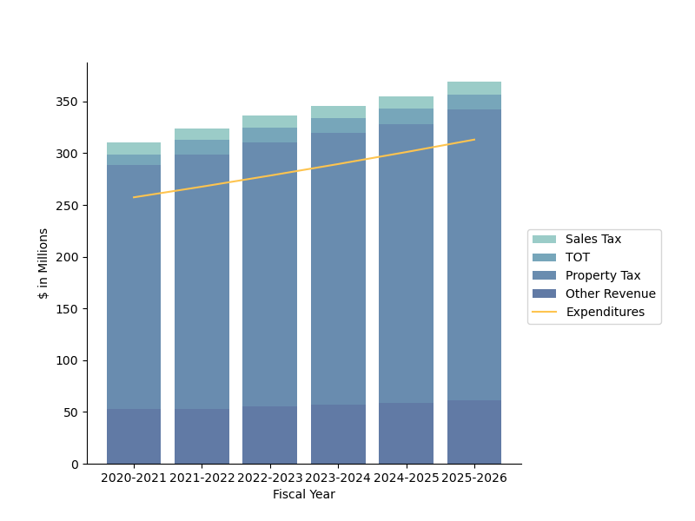
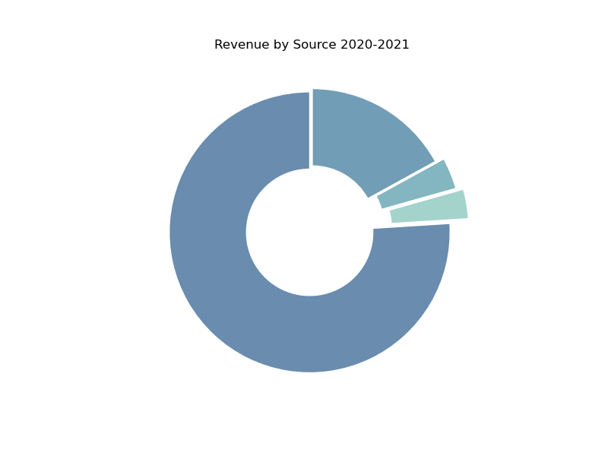
ID number: 43638161
Santa Barbara County Discretionary General Fund
Five-Year Forecast -Quickview
The financial position of the discretionary General Fund is strong, with growth projected in all of the top revenue sources and significant annual surpluses projected throughout the forecast period.
Discretionary General Fund
Revenue and Expenditure Forecast
350
300
250
200
150
100
50
0
$345.49M
$354.99M
$369.19M
$310.13M
$324.09M
$336.24M
$289.54M
$301.12M
$313.17M
$257.40M
$267.70M
$278.40M
Sales Tax
TOT
Property Tax
Other Revenue
Expenditures
$ in Millions
2020-2021 2021-2022 2022-2023 2023-2024 2024-2025 2025-2026
Fiscal Year
I. Revenue
Discretionary General Fund
Revenue by Source
FY 2020-2021
Other
17%
Sales Tax
3.6%
Transient
Occupancy Tax
3.4%
Property Tax
76%
1

Slide 2
ID number: 43638161
Property Tax
Property tax, by far the largest source of discretionary revenue, is expected to experience moderate to strong growth throughout the forecast period.
Transient Occupancy Tax (TOT)
With a return to normal tourism activity as the state of the COVID-19 pandemic improves, Transient Occupancy Tax revenue is expected to rebound significantly. This rebound is expected in the first fiscal year of the forecast, with an estimated increase of around 30% in FY 2021-2022, followed by modest growth in the following years. This growth is expected to return TOT to its place as the second largest source of discretionary revenue by FY 2021-2022.
Sales Tax
Sales Tax revenue is expected to grow modestly and consistently throughout the forecast period.
Other Revenue Sources
Cumulatively, all other sources of discretionary revenue make up a significant portion of the total (17% of discretionary revenue in the current fiscal year).
For the current forecast, all other revenue (Other Revenue) is projected based on the assumption of Property Tax revenue continuing to constitute 76% of total discretionary revenue. This allows for an average annual growth rate of 3.1% for Other Revenue. These projections, as well as those for total discretionary revenue and the financial position should be viewed as less precise estimates than those for primary revenue sources, as they are based on this assumption rather than more rigorous economic analysis. However, this uncertainty is only in the precise magnitude of these projections and does not impact the conclusions of this report.
II. Expenditure
Total Expenditure, composed primarily of Salaries and Benefits, is projected to increase steadily and consistently throughout the forecast period.
III. Financial Position
The discretionary General Fund is in a state of surplus in the current fiscal year. A consistent and healthy annual surplus of between $52 and $58 million is projected throughout the forecast period.
Growth in Expenditures is expected to outpace growth in the three primary discretionary revenue sources by FY 2023-2024. Therefore, without the revenue from other sources, the General Fund would be projected to run an increasing annual deficit, from around $900,000 in FY 2023-2024 to $5.4m in FY 2025-2026.
2

Slide 3
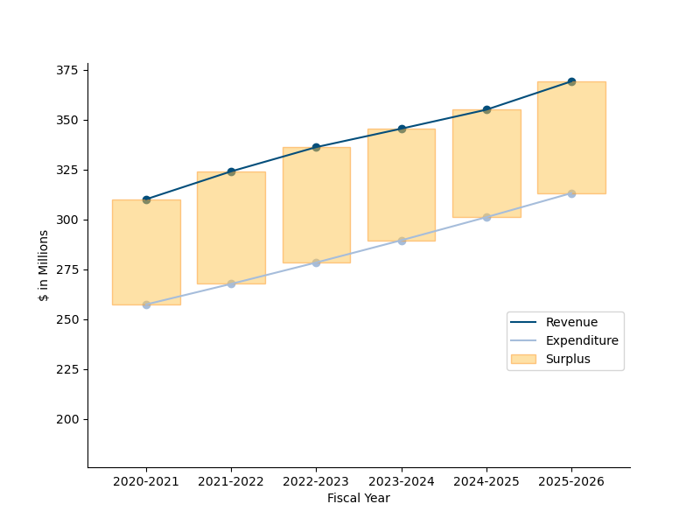
ID number: 43638161
Discretionary General Fund
Forecasted Surplus
375
350
325
300
275
250
225
200
$53.87M
$56.02M
$57.84M
$55.95M
$ in Millions
$52.73M
$56.40M
Revenue
Expenditure
Surplus
2020-2021 2021-2022 2022-2023 2023-2024 2024-2025 2025-2026
Fiscal Year
IV. Key Takeaways
FY 2021-2022 is expected to be a year of strong revenue growth in Property Tax and TOT, bolstering current surpluses. This is projected to be proceeded by a return to relatively stable and moderate growth.
As the discretionary General Fund relies heavily on property tax revenue (accounting for over three quarters of total discretionary revenue), it is vulnerable to any volatility in this revenue source. Impacts of relevant policy (such as Prop 19) should be closely monitored.
Stable and significant annual surpluses are projected to continue for the next five years. However, with high and stable growth in expenditures, these surpluses rely increasingly on revenue from sources other than Property Tax, Sales Tax and TOT.
3

Slide 4
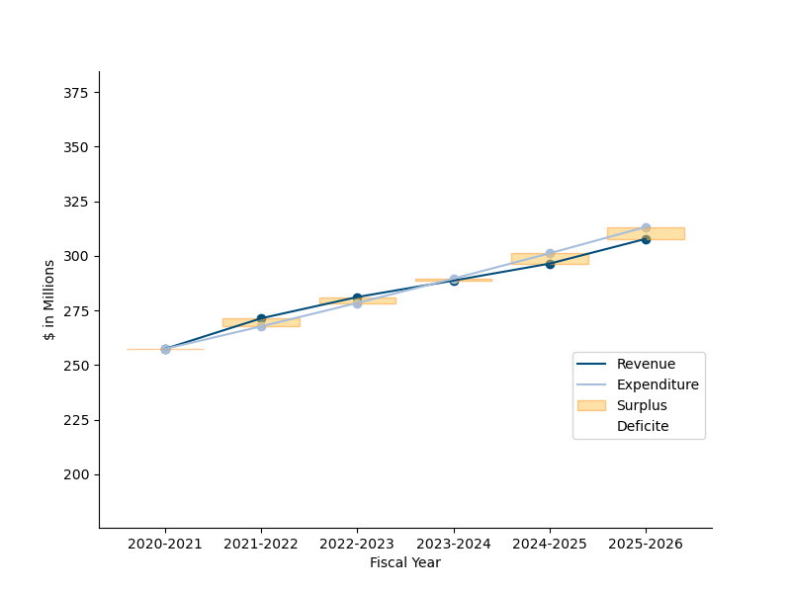
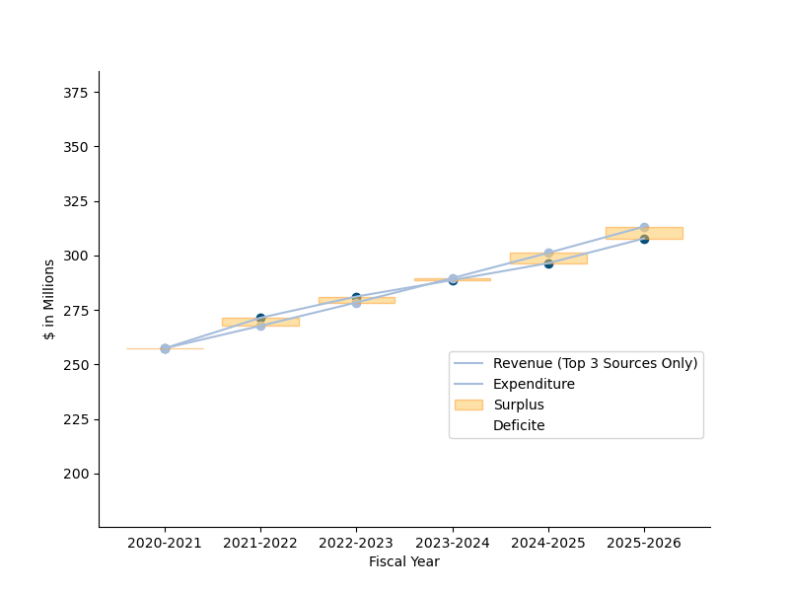
ID number: 43638161
Appendix
Table 1.
Discretionary General Fund
Projected Revenue by Source (In Millions of Dollars)
Fiscal Year | Property Tax Revenue | Transient Occupancy Tax Revenue | Sales Tax Revenue | Other Revenue | Total Revenue
2020-2021 | $ 235.70 | $ 10.50 | $ 11.20 | $ 52.73 | $ 310.13
2021-2022 | $ 246.31 | $ 13.65 | $ 11.42 | $ 52.71 | $ 324.09
2022-2023 | $ 255.54 | $ 13.92 | $ 11.65 | $ 55.12 | $ 336.24
2023-2024 | $ 262.57 | $ 14.20 | $ 11.89 | $ 56.83 | $ 345.49
2024-2025 | $ 269.79 | $ 14.49 | $ 12.12 | $ 58.59 | $ 354.99
2025-2026 | $ 280.58 | $ 14.78 | $ 12.37 | $ 61.46 | $ 369.19
4

